Slide 1
Springboot Startup Process
Springboot version: 2.0.6.RELEASE
Spring version: 5.0.10
PS

Slide 2
Agenda
Springboot architecture
SpringApplication Initialization
SpringApplication.run method
@SpringBootApplication annotation

Slide 3
Springboot architecture
Auto-configuration
Starter-poms
Notes:
https://mp.weixin.qq.com/s/bf8E3ET9EehDl4cCtGfjIg
https://github.com/spring-projects/spring-boot/wiki/Building-On-Spring-Boot
https://docs.spring.io/spring-boot/docs/current/reference/html/boot-features-developing-auto-configuration.html

Slide 4
Concetps
The concept of auto-configuration and starter-POMs are related, but not directly tied:
Auto-configuration is responsible for reacting to the current state of an application and configuring appropriate Spring Beans. More often than not, the primary driver for auto-configuration will be the users classpath.
Starter POMs are responsible for pulling in dependencies that are commonly used together.
In other words, Starter POMs configure the classpath, and auto-configuration reacts to it.
Notes:
在Spring Boot中包含两个概念: auto-configuration和starter-POMs, 它们之间相互关联，但并非简单绑定在一起的：
a. auto-configuration负责响应应用程序的当前状态，并配置适当的Spring Bean。它放在用户的CLASSPATH中，结合在CLASSPATH中的其它依赖，就可以提供相关的功能；
b. Starter-POM负责把auto-configuration和一些附加的依赖组织在一起，提供开箱即用的功能，它通常是一个maven project, 里面只是一个POM文件，不需要包含任何附加的classes或resources；
“换句话说，starter-POM负责配置全量的classpath, 而auto-configuration负责具体的响应(实现)；
前者是total-solution, 后者可以按需使用。
若用单一的一个module把auto-configuration和starter-POM混在了一起，将不利于以后的扩展和模块的单独使用。”

Slide 5
Separation
We generally find that keeping these two concepts separate helps for the following reasons:
There is clean separation of concerns between auto-configuration and dependency management.
Users can still take advantage of auto-configuration without starter POMs. For example if they use an Application Server that provides dependencies, or if they are in a highly regulated industry where all dependencies must be vetted.
Auto-configuration works if a dependency is available for another reason. For example, if the user already has Tomcat, it makes sense to provide specific Tomcat support without requiring a new starter.
It can help to reduce the number of starters that are required.
Notes:
把auto-configuration和start-poms两个概念分开的好处：
自动配置和依赖管理两者有清晰的关注点的不同。
用户在不使用依赖管理的情况下依然可以使用自动配置。例如在一个高度管制的行业里，所有的依赖包都必须经过审查。
XXX
可以帮助我们减少starter的数量

Slide 6
SpringApplication constructor
Initialize properties
resourceLoader
primarySource
webApplicationType
mainApplicationClass
SpringFactoriesLoader
setInitializer
setListener

Slide 7
resourceLoader
DefaultResourceLoader
GenericApplicationContext
PathMatchingResourcePatternResolver
Notes:
SpringApplicationBannerPrinter
private Banner getTextBanner(Environment environment) {
Resource resource = this.resourceLoader.getResource(location);

Slide 8
DefaultResourceLoader
Base class for AbstractApplicationContext

Slide 9
primarySources
Application.class

Slide 10
webApplicationType
WebApplicationType.deduceFromClasspath()
Check the classpath of current project, if some class present, then we could consider which application type current project is.
Application type
SERVLET_INDICATOR_CLASSES
WEBMVC_INDICATOR_CLASS
WEBFLUX_INDICATOR_CLASS
JERSEY_INDICATOR_CLASS
SERVLET_APPLICATION_CONTEXT_CLASS
REACTIVE_APPLICATION_CONTEXT_CLASS
Notes:
SERVLET_INDICATOR_CLASSES: "javax.servlet.Servlet", "org.springframework.web.context.ConfigurableWebApplicationContext"
WEBMVC_INDICATOR_CLASS: "org.springframework.web.servlet.DispatcherServlet";
WEBFLUX_INDICATOR_CLASS: "org. springframework.web.reactive.DispatcherHandler";
JERSEY_INDICATOR_CLASS: "org.glassfish.jersey.servlet.ServletContainer";
SERVLET_APPLICATION_CONTEXT_CLASS: "org.springframework.web.context.WebApplicationContext";
REACTIVE_APPLICATION_CONTEXT_CLASS: "org.springframework.boot.web.reactive.context.ReactiveWebApplicationContext";

Slide 11
mainApplicationClass
Generate a pseudo RuntimeException
Find the main method from StackTraces of the pseudo RuntimeException.
Get the MainApplication class from the StackTrace which is the owner of main method.
Notes:
StackTraceElement[] stackTrace = new RuntimeException().getStackTrace(); for (StackTraceElement stackTraceElement : stackTrace) { if ("main".equals(stackTraceElement.getMethodName())) { return Class.forName(stackTraceElement.getClassName()); } }

Slide 12
SpringFactoriesLoader
FACTORIES_RESOURCE_LOCATION = "META-INF/spring.factories";
Get class instances according to factoryClassName
getSpringFactoriesInstances(ApplicationContextInitializer.class))
getSpringFactoriesInstances(ApplicationListener.class)
Notes:
# Initializers org.springframework.context.ApplicationContextInitializer=\ org.springframework.boot.autoconfigure.SharedMetadataReaderFactoryContextInitializer,\ org.springframework.boot.autoconfigure.logging.ConditionEvaluationReportLoggingListener
# Application Listeners org.springframework.context.ApplicationListener=\ org.springframework.boot.autoconfigure.BackgroundPreinitializer

Slide 13
setInitializers
getSpringFactoriesInstances
ConfigurationWarningsApplicationContextInitializer
ContextIdApplicationContextInitializer
DelegatingApplicationContextInitializer
ServerPortInfoApplicationContextInitializer
Notes:
https://www.colabug.com/3756277.html
ConfigurationWarningsApplicationContextInitializer (对ComponentScan指定的值为"org"等进行报警输出)
ContextIdApplicationContextInitializer (创建默认名为application的ContextId对象，也可通过spring.application.name指定)
DelegatingApplicationContextInitializer (对context.initializer.classes指定的class集合进行加载)
ServerPortInfoApplicationContextInitializer (将local.server.port设置为指定的web端口，默认为8080)

Slide 14
setListener
getSpringFactoriesInstances
ClearCachesApplicationListener
ParentContextCloserApplicationListener
FileEncodingApplicationListener
AnsiOutputApplicationListener
ConfigFileApplicationListener
DelegatingApplicationListener
ClasspathLoggingApplicationListener
LoggingApplicationListener
LiquibaseServiceLocatorApplicationListener
Notes:
ClearCachesApplicationListener (反射工具缓存清空事件)
ParentContextCloserApplicationListener (父ApplicationContext关闭事件)
FileEncodingApplicationListener (系统变量配置的file.encoding值是否与环境变量spring.mandatory-file-encoding一致事件)
AnsiOutputApplicationListener (控制台彩色输出事件，可通过spring.output.ansi.enabled来指定)
ConfigFileApplicationListener (读取spring.profile.active/spring.profile.include配置)
DelegatingApplicationListener (委托事件处理类)
ClasspathLoggingApplicationListener (打印classpath信息，级别为debug)
LoggingApplicationListener (日志处理事件)
LiquibaseServiceLocatorApplicationListener (classpath是否存在liquibase的CustomResolverServiceLocator类判断事件)

Slide 15
SpringApplication.run
Configure Headless Property
Starting listeners
Prepare environment
Configure ignore bean information
Print Banner
Create application context
Initiate exceptionReports
Prepare context
Notes:
prepareContext
load(context, sources.toArray(new Object[0]));
加载所有的Spring bean

Slide 16
SpringApplication.run
Refresh context
After refresh context
Listeners started
Call runners
Listeners running

Slide 17
Configure headless
configureHeadlessProperty();
If the application is headless, then it won’t instantiate AWT.
Notes:
if the application is headless and should not instantiate AWT

Slide 18
Starting listeners
SpringApplicationRunListeners listeners = getRunListeners(args); listeners.starting();
EventPublishingRunListener
Publish events to all ApplicationListeners of current applicationcontext.
Notes:
Refer: AbstractApplicationContext

Slide 19
prepareEnvironment
getOrCreateEnvironment()
configureEnvironment()
listeners.environmentPrepared(environment)
bindToSpringApplication(environment)
ConfigurationPropertySources.attach(environment);

Slide 20
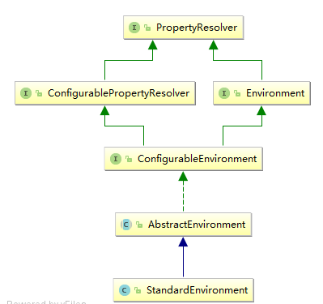
StandardEnvironment

Slide 21
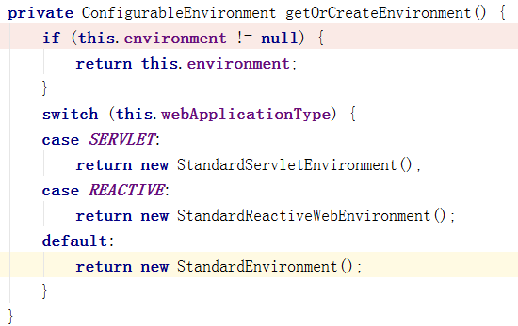
getOrCreateEnvironment

Slide 22
listeners.environmentPrepared
读取配置文件 ConfigFileApplicationListener.load
Notes:
https://www.cnblogs.com/tanliwei/p/9304072.html
https://www.cnblogs.com/liruiloveparents/p/9492797.html

Slide 23
configureEnvironment
Set conversionService by default configuration.
environment.setConversionService((ConfigurableConversionService) conversionService);
DCL
configurePropertySources(environment, args);
configureProfiles(environment, args);
Notes:
配置Application.yml
Application-dev.yml
Designed for direct instantiation but also exposes the static addApplicationConverters and addApplicationFormatters(FormatterRegistry) utility methods for ad-hoc use against registry instance.

Slide 24
prepareContext
Load
this.primarySources = new LinkedHashSet<>Arrays.asList(primarySources));
看上去是手动把类加入Spring容器

Slide 25
BeanPostProcessor
BeanPostProcessor在什么时候处理？

Slide 26
Spring Annotation
Notes:
https://blog.csdn.net/dm_vincent/article/details/76735888

Slide 27
